Slide 1
IT Works @ AP Support
Analyzing your portfolio with an API
10-9-2020
Wouter Mertens
Naarden

Slide 2

Inhoud
Introduction
What are API’s
How does a client side browser API work
Roadmap working with client side API
Demo

Slide 3

Introduction
About Me
Name: Wouter Mertens
Function: Innovation Manager
Working Experience: +10 years
Trained in: Finance, Actuarial Sciences, IT, Consultancy
Hobby’s: Traveling (Italy), Wine, Programming

Slide 4

Introduction
About AP Support
Founded in: 1997
Branche: Financial Services
Kind of company: Consultancy firm
Number of employees: Circa 170
Mission employees: Provide employees with relevant experience to succeed in the financial industry.
Mission customers: Provide customers with innovative solutions with clear added value.

Slide 5
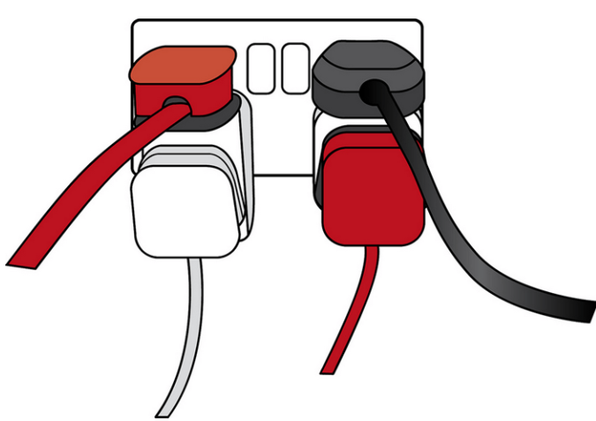
What are API’s
An API is an Application Programming Interface.
There are many API codes but generally we are talking about Browser API’s.
Currently information is mostly being shared through API’s using http requests. This allows anyone to access data in the database.

Slide 6
What are API’s
On the one hand you have the server API which delivers the information from the browser to the database or vice versa.
On the other hand you have the client API which delivers the information from the browser to the client or vice versa.
We will be working with the client side and getting information from the server of IEXcloud.io

Slide 7




How does a get client-side browser API work
url
http request
Getting a static website (no database)
From a Server

Slide 8


How does a get client-side browser API work
url
http request
A client-side API (Get) works like getting data from a
dynamic website (database)

Slide 9
How does a get client-side browser API work
Show all stocks API
https://api.iextrading.com/1.0/ref-data/symbols

Slide 10

Roadmap working with client side API
When working with an API four steps must be taken
Setting up the connection
Getting the data
Parsing the data
Handling/ storing the data

Slide 11

Demo
In the demo we will be making three things:
Getting all possible stock available
Getting prices of stock for examining our portfolio
Getting current prices of stock to examine (creating Ticker)

Slide 12
Demo (API codes we will be using)
Getting all shares:
https://api.iextrading.com/1.0/ref-data/symbols
Getting shares of specific stock last 6 months (analysis of portfolio)
https://cloud.iexapis.com/stable/stock/???/chart/6m?token=TOKEN
Getting latest prices of stock (for the ticker)
https://cloud.iexapis.com/stable/stock/???/quote?token=TOKEN

Slide 13

Questions
Questions?
Send an email to woutermertens@apsupport.nl

